Slide 1
Designing the Refugee and Asylum Interview Experience
Logo
Product Design Lead: Taylor Gandolfi Santos
Product Manager Lead: Maggie Larkin

Slide 2
What is a Refugee / Asylum interview?
Level Setting

Slide 3
Refugee / Asylum Interview
Procedures
Testimony
Introductory
Form Review
Forms: 590, 589, 870, 730
Review form data, make changes, signature
Conclusion
Claim
Assess eligibility on protected ground
Race
Religion
Nationality
Political Opinion
Particular Social Group
Past Persecution
Well-Founded Fear
Assess credibility

Slide 4
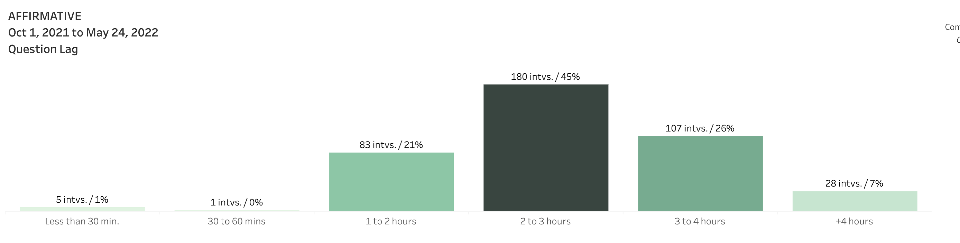
Interview Times & GINA Completions by Officer

Slide 5
Make RAIO Interviews Better
Initial Scope & Business Ask

Slide 6
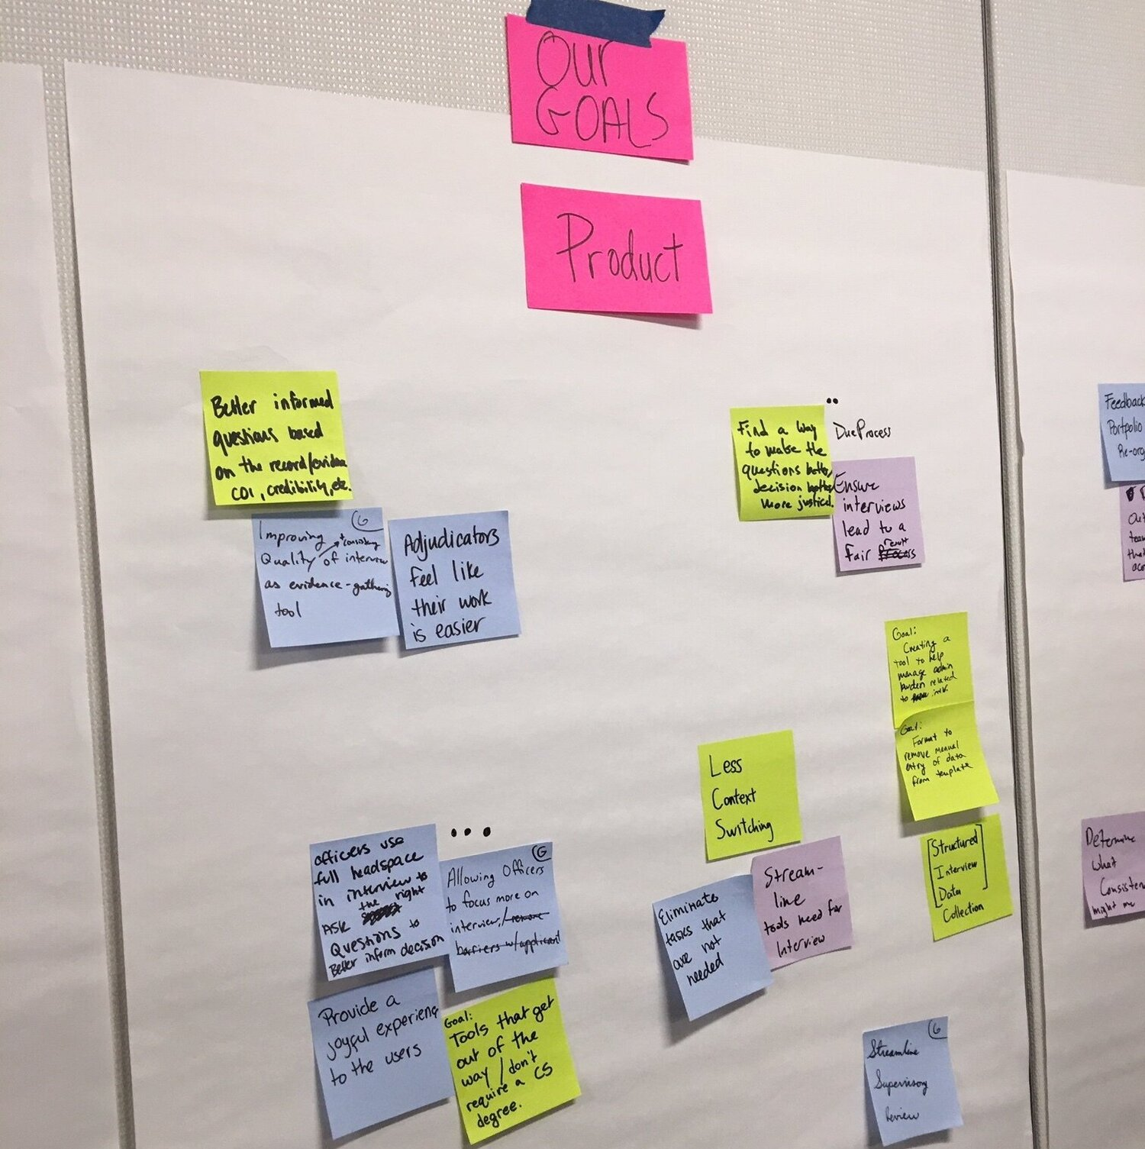
Goals
Business Goals
Increase consistency with interviews across officers, offices, and case types
Increase meaningful work and decrease busywork
Decrease ramp-up time for new officers
Decrease ramp-up time when officers switch case types
Decrease re-interviews and re-work
Product Goals
Provide business with structured interview data collection to measure how long specific parts of interviews take as well as specific case types
Decrease context switching during interviews
User adoption
Eliminate unneeded tasks
Facilitated design thinking exercises with business stakeholders to kick-off discovery research and define business and product goals.

Slide 7
Defining the Problem

Slide 8
Process
Top Problem
Officers missing important details and not conducting thorough interviews
Top Solution
Guiding officers through what needs to be covered in an interview
Discovery
Interviewed officers, supervisors, SME, stakeholders to find top problems
Framing
Prototyped and tested very different lo-fi solutions
Many user interviews
Problem Prioritization
Many usability tests
Solution Prioritization
Solution Prioritization
Many Problems
Fewer Problems
Many Solutions
Fewer Solutions

Slide 9
Problem Statement
I am an officer inexperienced in this case type
Trying to conduct a thorough, legally sufficient, and just interview​
But I have trouble keeping track of all the important details​
Because there are too many aspects to explore ​
Which makes me feel burned out by re-work​

Slide 10
Initial Solutioning

Slide 11
Vision
To clear a path for officers to fully understand an applicant’s story leading to more consistent and just outcomes
Digitization of interview notes to unlock a seamless adjudication experience
Scalable for interviews across case types

Slide 12
Initial Outcomes
Increase quality of interviews so that officers are more confident in decisions.
Affirmatives Asylum cases are processed more efficiently by reducing re-work.
Less ramp up time for new officers.

Slide 13
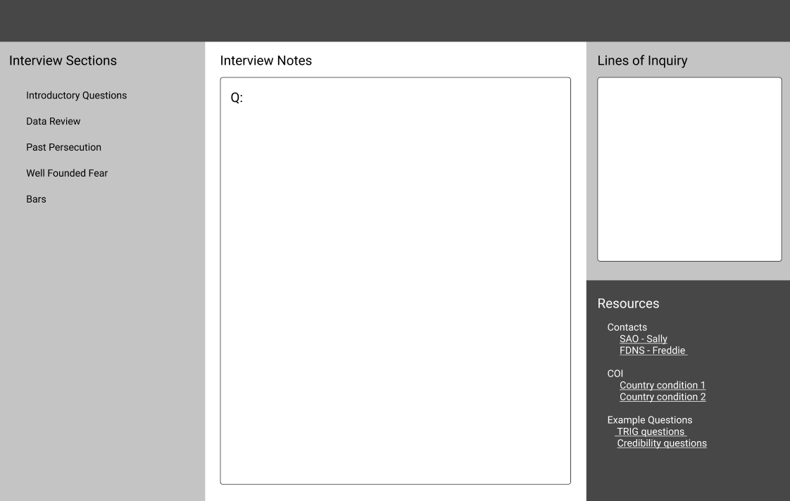
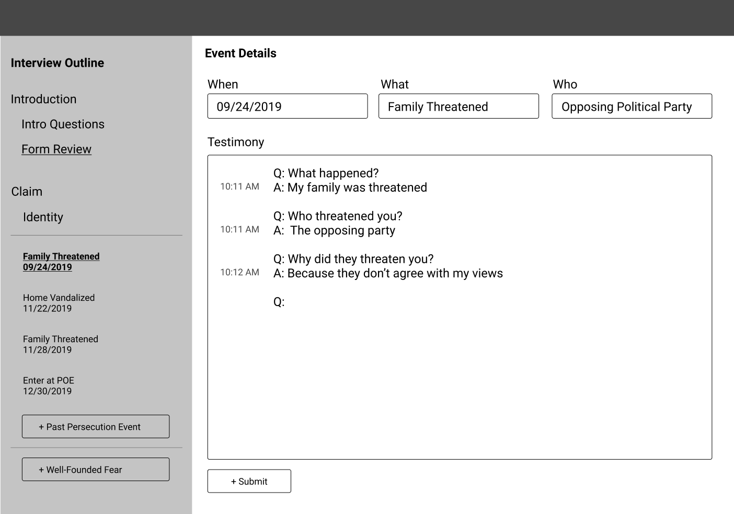
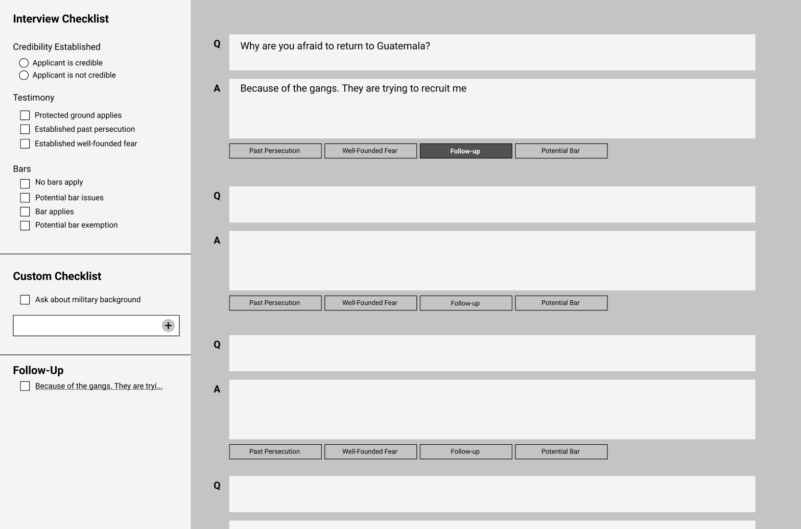
Testing various solutions….
Concept 1: Roadmap
Assumption: Capturing testimony in narrative format will help officers elicit all needed testimony
Results: Did not work. Officers felt uncomfortable not typing the interview verbatim and felt they might miss details
Concept 2: Timeline
Assumption: It helps officers cover all events in testimony by structuring the interview in a timeline
Results: Did not work. Every element of the interview does not fit into a timeline format
Concept 3: Checklist
Assumption: A checklist will provide a reminder to officers of everything that needs to be covered during an interview
Results: Winning concept. Officers felt the checklist was extremely helpful, especially newer officers, and many built their own checklist in Word

Slide 14
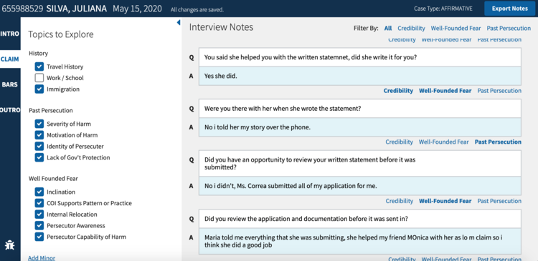
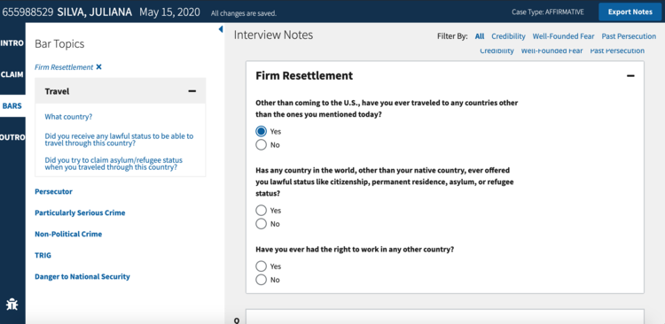
Pilot at Arlington Asylum Office and Lean MVP
Initial Pilot included 6 officers and 1 supervisor
Expanded to 3 offices
Expanded to make optional for all officers
Checklist to cover all elements of the interview
Follow-up support for difficult situations

Slide 15
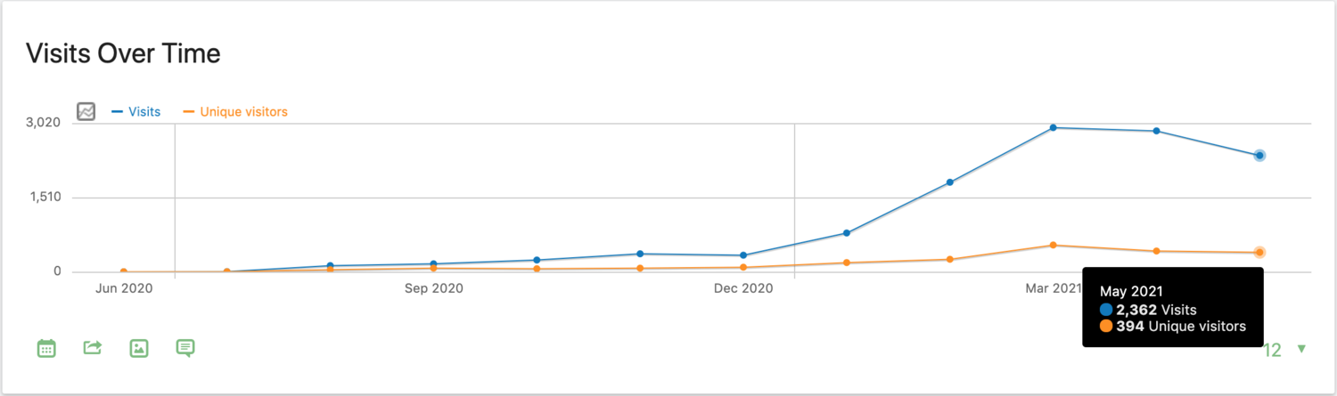
Pilot Feedback
I have heard from attorneys that bar questions for children are much better, and they appreciate that we can adapt questioning to younger ages.” Asylum Officer
“Ever since I started using Global Interview, all my cases have been approved. Before my Supervisor would be like hey you didn’t ask this question, you didn’t do this thing. Last week, I asked him for feedback and there was nothing. It’s a great feeling to not get anything sent back, thanks to you guys.” Asylum Officer
Adoption during pilot

Slide 16
Make APSO Interviews Better
Initial Scope & Business Ask

Slide 17
Defining the Problem

Slide 18
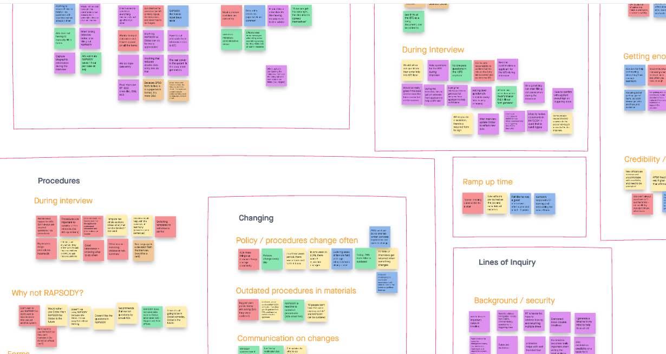
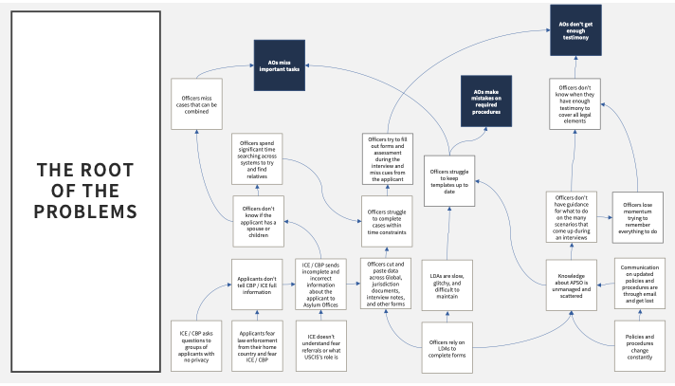
Defining the Problem
Lots of quotes
Synthesize

Slide 19
Problem Statement
I am an asylum officer working on APSO,
Trying to conduct a complete and correct interview.
But my template might not incorporate the latest procedures,
Because I don't know if there's a new policy
makes me feel nervous that I'll have another return.

Slide 20
APSO Solutioning

Slide 21
APSO Outcomes
Content in Global Interview is up to date and reliable.
Officers capture all necessary information during the interview for downstream forms.

Slide 22
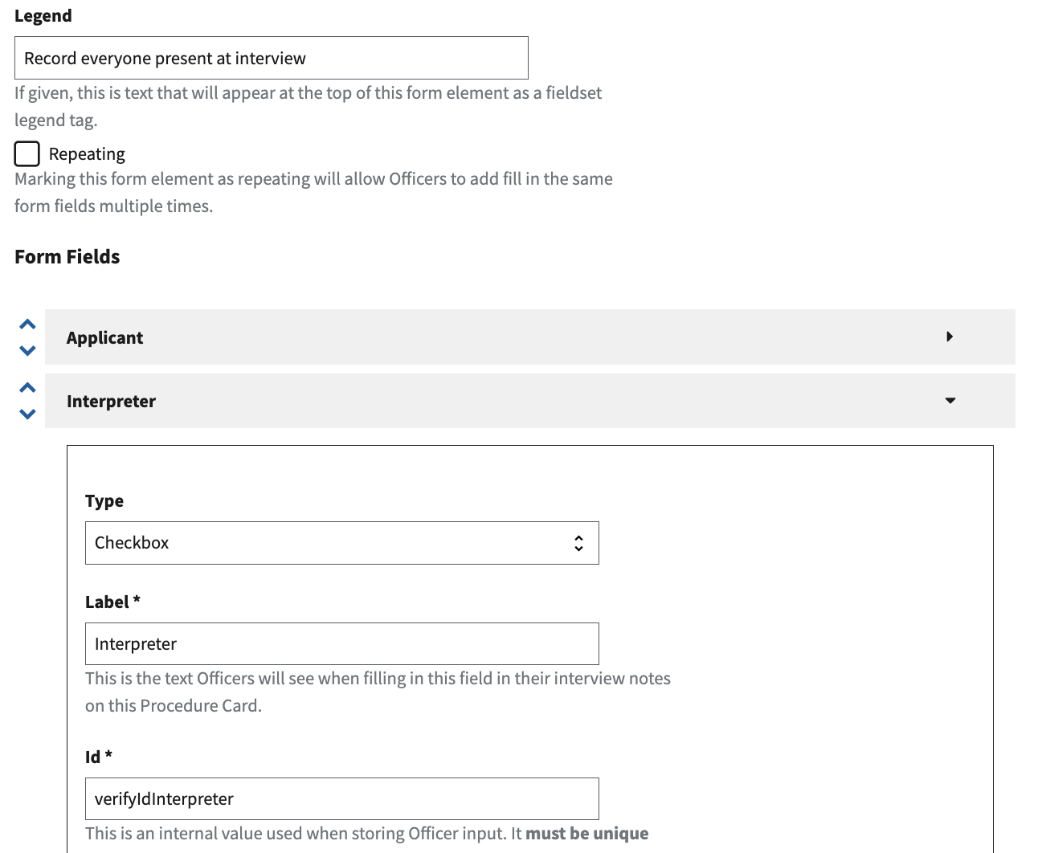
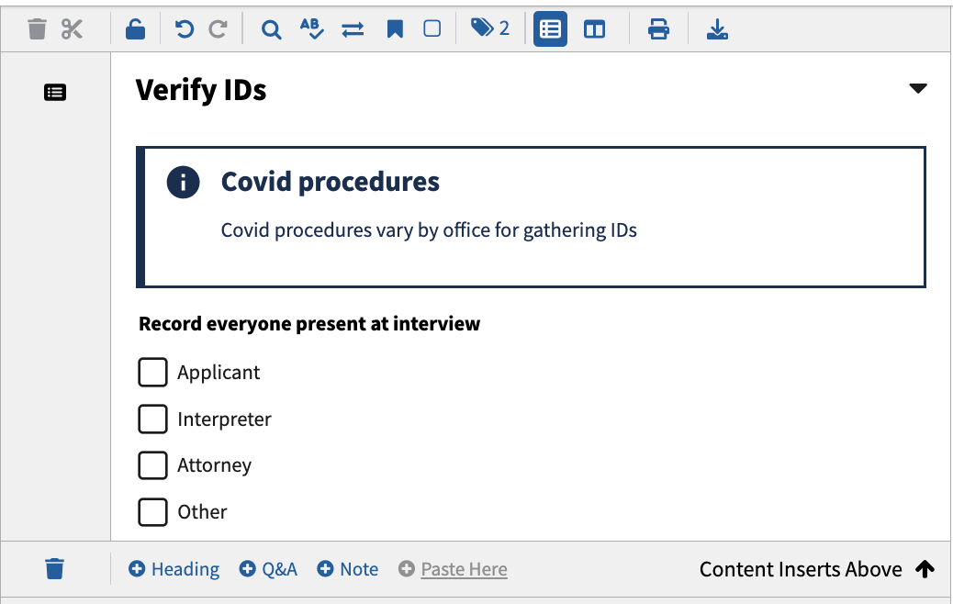
Content is up to date and reliable
Backend
Frontend

Slide 23
Results
Can make changes to procedures the same day they come out
Probably close to 1000 hours of dev time saved
Build forms in days

Slide 24
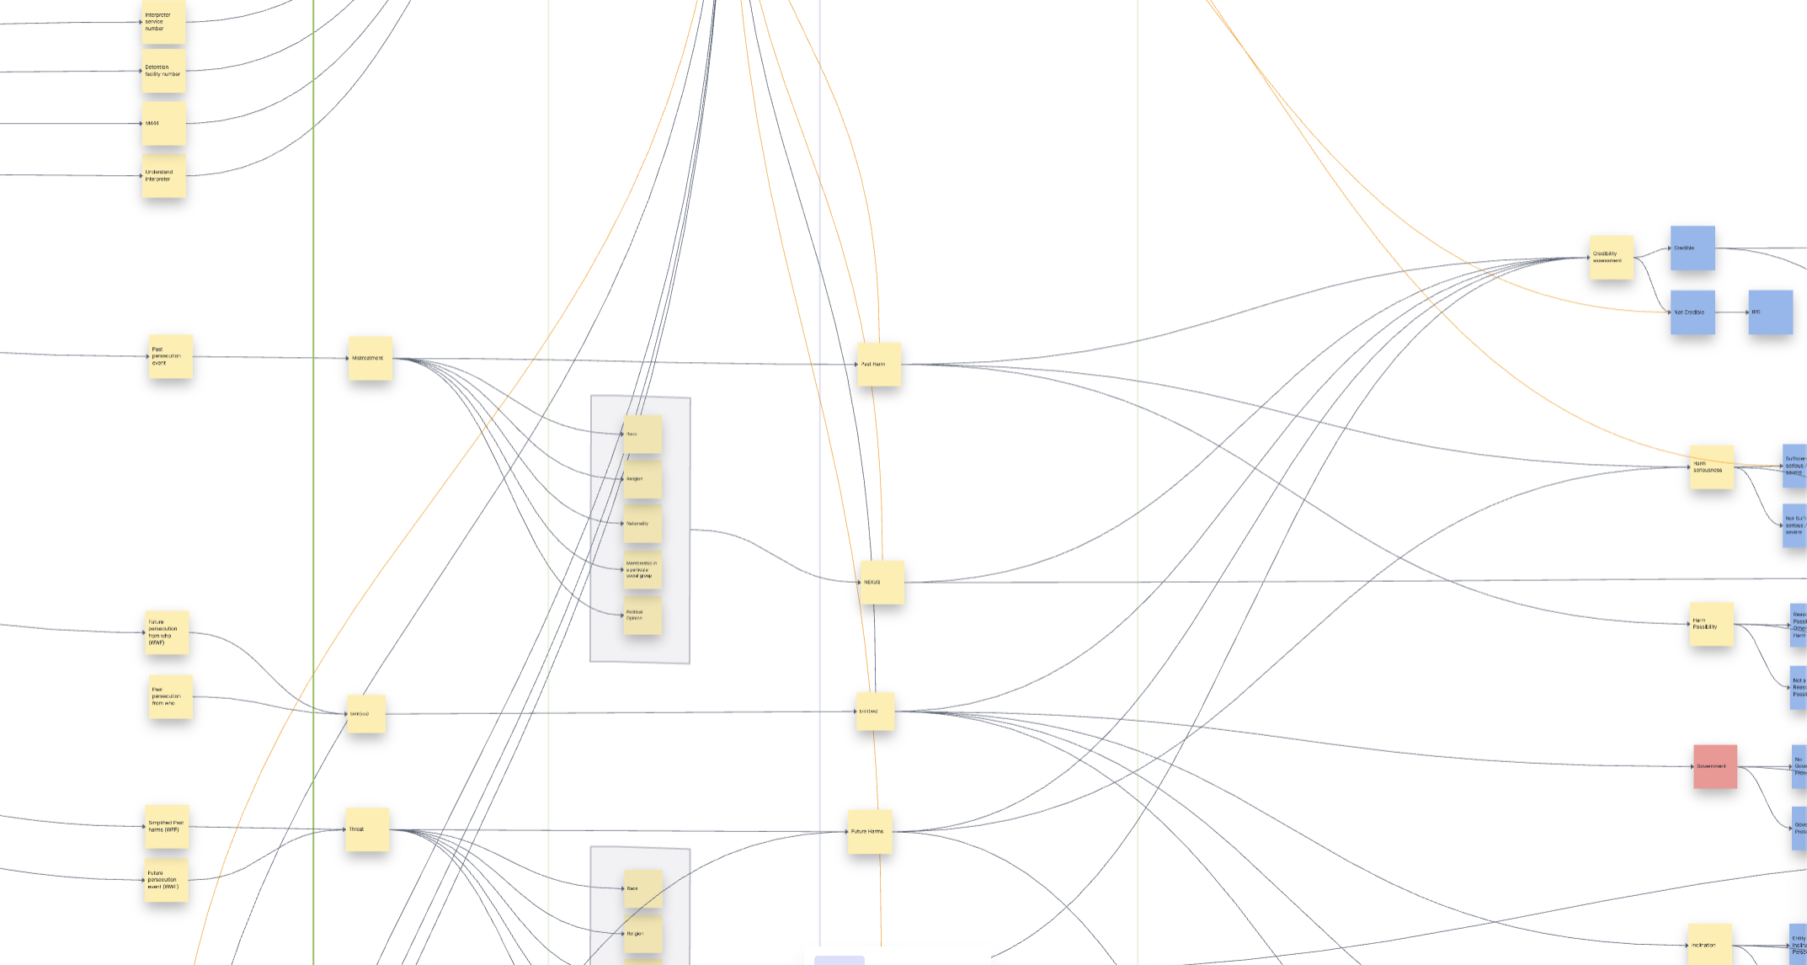
No duplication

Slide 25
And then COVID happened…

Slide 26
Get signatures with minimal physical contact
Initial Scope & Business Ask

Slide 27
Defining the Problem

Slide 28
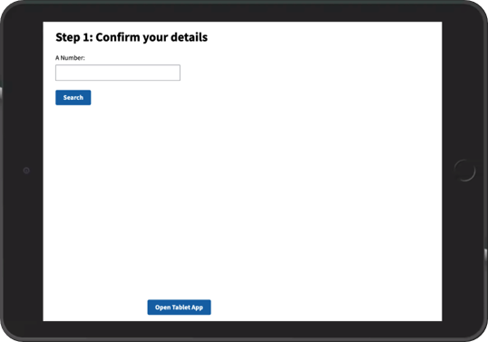
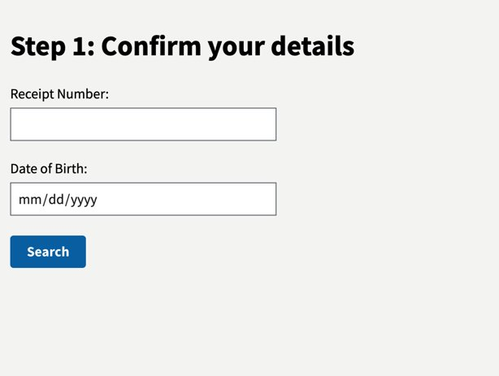
Where we started
Lean MVP – What we already had
Business Needs
Digital 589 Review is needed for eProcessing
Signatures are needed at the right time, from the right applicant, for the right form
Reduce physical contact with applicant and officer during interviews due to COVID
User Needs
Applicants need to be able to navigate the tablet without written instructions
The officer needs to have as much control of the applicant experience as possible
Tech Needs
Digital signature solution needs to securely authenticate the applicant's identity
The forms the applicant signs, need to be attached to the applicant's case in Global
“Applicants don’t know what their receipt number is, and it’s not clear that you need to touch the receipt # box in order to get the keyboard to display, I think that part is really hard for the applicant.”
– AO, ZOL

Slide 29
Two Main Hurdles
Applicants have trouble navigating the tablet
“[Applicants] are bewildered by this process because it’s so unfamiliar” – Asylum Officer
Officers don’t have enough control over the tablet experience, and are in the dark
“In my opinion the most helpful change would be for the AOs to somehow be able to view the screen of the applicant so we can follow along on what their seeing, otherwise we are in the dark.”​ - Asylum Officer

Slide 30
Remote Interviews Solutioning

Slide 31
Remote Interview Outcomes
Applicant Navigation
Applicants can navigate the tablet without Asylum Staff physically entering the room
Officers can explain next steps to applicant remotely
Officer Control
Officer can remotely attach applicant information to signed forms
Officer can connect and control applicant tablet remotely and securely

Slide 32
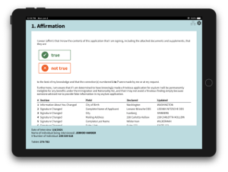
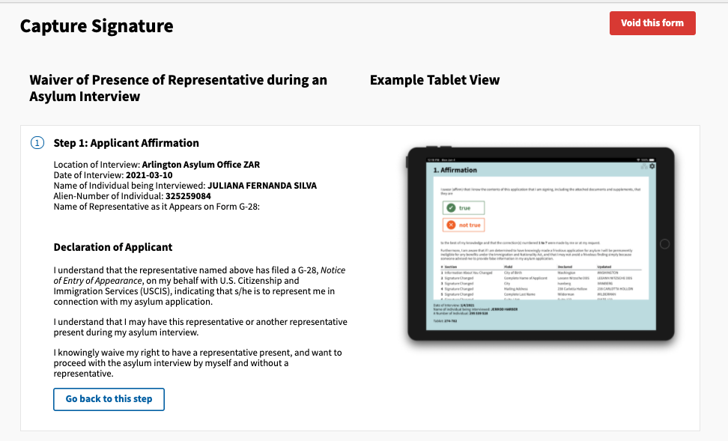
Applicant Navigation
Solution
Language agnostic patterns such as symbols and colors to help the applicant understand what to do
Help the officer understand what step the applicant is on
Features
Green / orange buttons for true / not true options
Arrow symbol for next step
Highlight what step the applicant is on for the officer

Slide 33

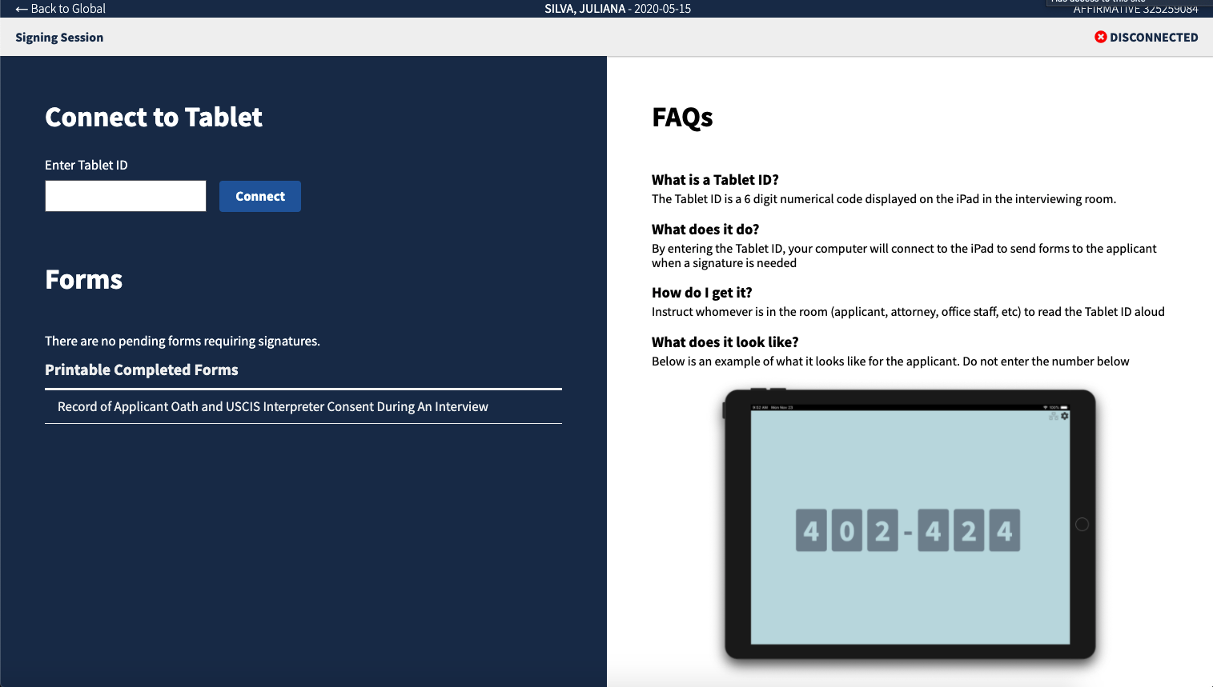
Officer Control
Solution
Officer opens esign from applicant case in Global > Global Interview Notes > eSign
Tablet connection and controls for the officer
Features
6-digit code on tablet screen connects applicant and officer experience
When connected, officer send relevant form to applicant from eSign
Officer ability to control applicant screen if needed

Slide 34
Feedback
From user testing
“WHAAAAT This is way easier! When can we use this? I know you guys can’t see me, but I was doing a little happy dance “ AO, ZOL Pilot
“That was pretty easy, I like it. It worked smoothly. I have an interview Friday, can I try it? I am very happy to move into the digital world.” -AO, ZNK
From Pilot
“The example tablet view is extremely helpful. This alleviates my concerns about not knowing what they’re supposed to be doing.”- AO, ZOL
“The signature part is a piece of cake!” - TO, ZSF

Slide 35
And then Afghanistan fell…

Slide 36
Make Refugee Interviews Better
Initial Scope & Business Ask

Slide 37
Defining the Problem

Slide 38
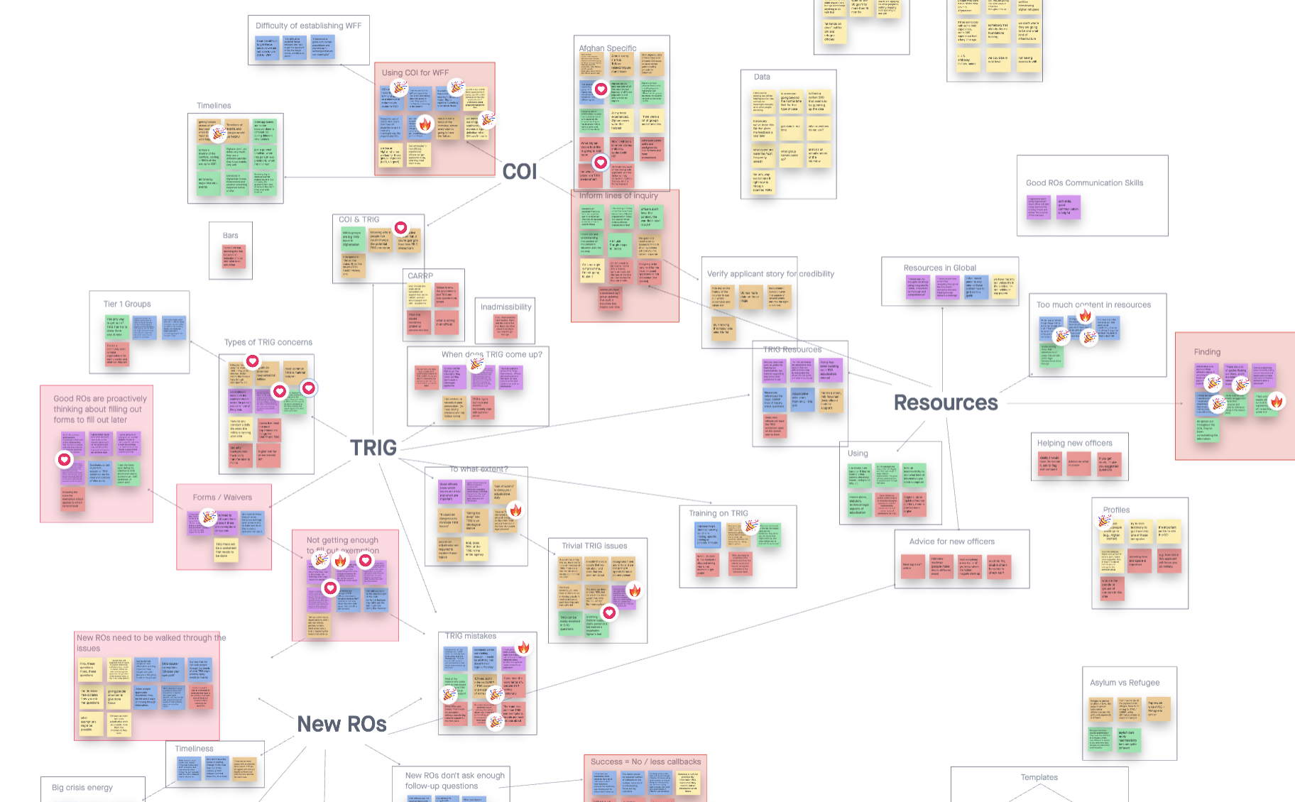
Discovery
Business Needs
To process Afghan refugee seekers in record time (weeks, not months)
(Potentially) have non-Refugee officers conducting refugee interviews
Make adjudication more real-time (non-paper based)
User Needs
To not lose their work, including in bad wifi/connectivity areas
Tech Needs
To save when not connected to the internet
To save when connected to the internet

Slide 39
Refugee Solutioning

Slide 40
Refugee Outcomes
Officers don’t lose work offline
Refugee Officers complete assessment in GINA

Slide 41
Officers don’t lose work offline
Now
Later
Save a local copy in browser
Saves to cloud when you come back online
Only one editor at a time
Desktop app?
Way to extract local copies?

Slide 42
Results
“At least twice last month my laptop froze and I had to restart. Thanks to GINA, I didn't lose any of the notes.” – Asylum Officer
“I was once taking notes on the Global notes tool and our whole office lost internet and not only did my notes not disappear but they saved the notes I made after we lost internet” – Asylum Officer
0 interview notes losses from Refugee Interviews

Slide 43

ROs complete assessment in GINA
Research
Idea
In user testing
“Officers are not going to like having to complete their interview notes in this system, they are used to having their interview and assessment in the same document” – Training Refugee Officer
Interview notes and assessment combined
Use this tool that can create procedure cards!

Slide 44
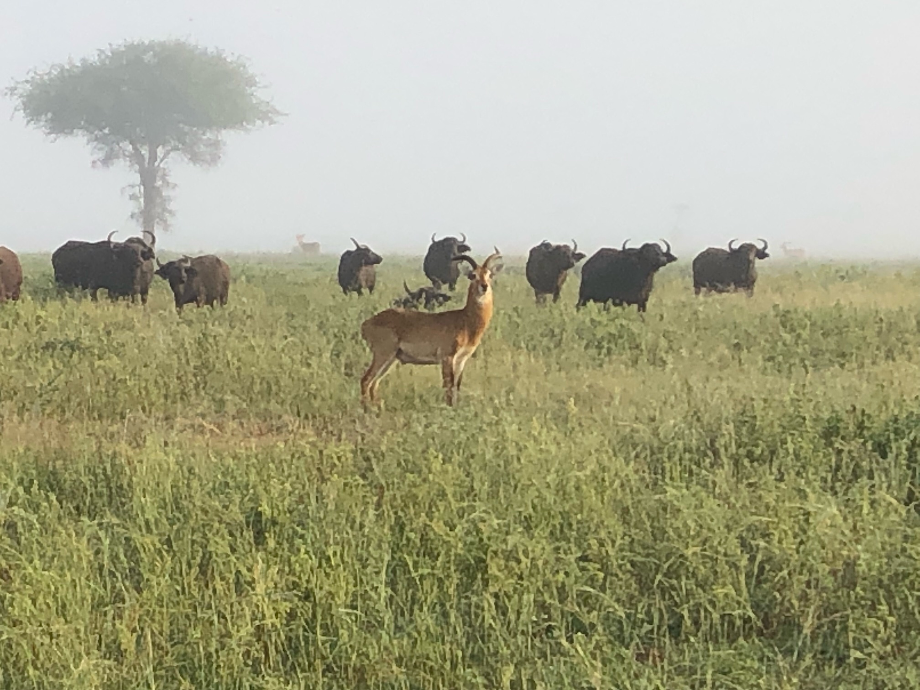
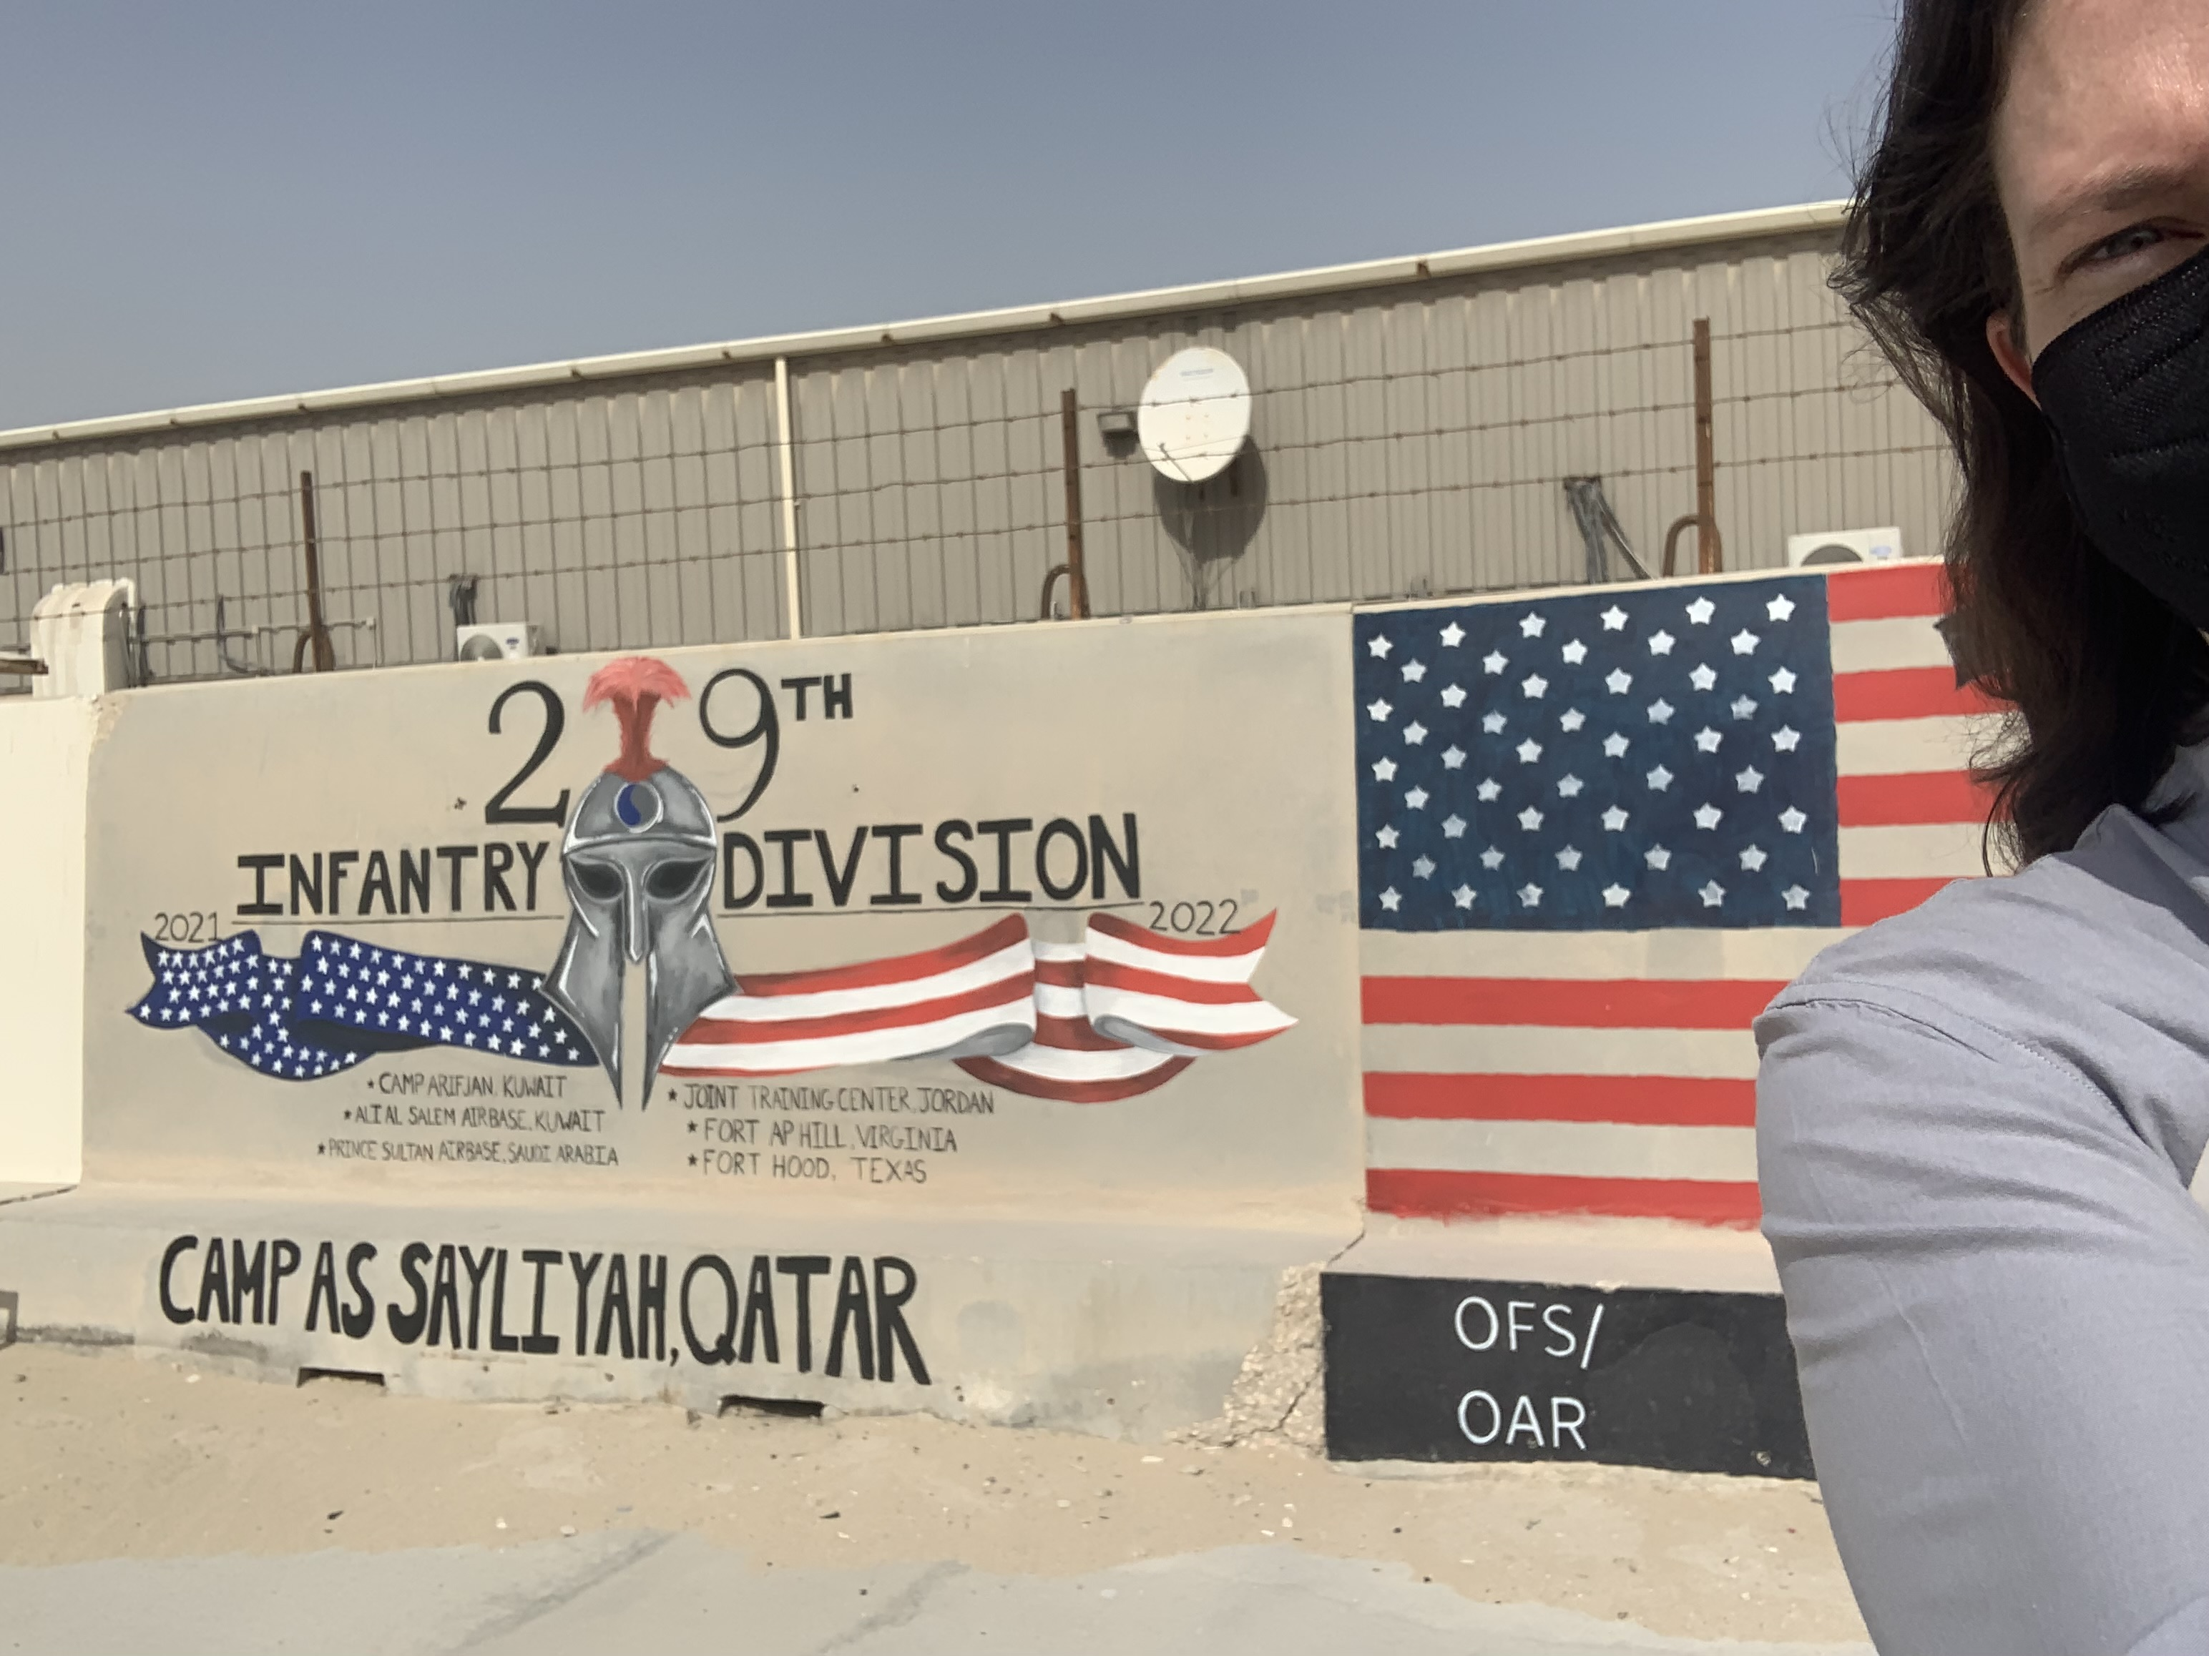
On the ground!
Taylor went to Africa
Maggie went to Qatar
Notes:
Source of Africa Image: Taken from Taylor’s iphone

Slide 45
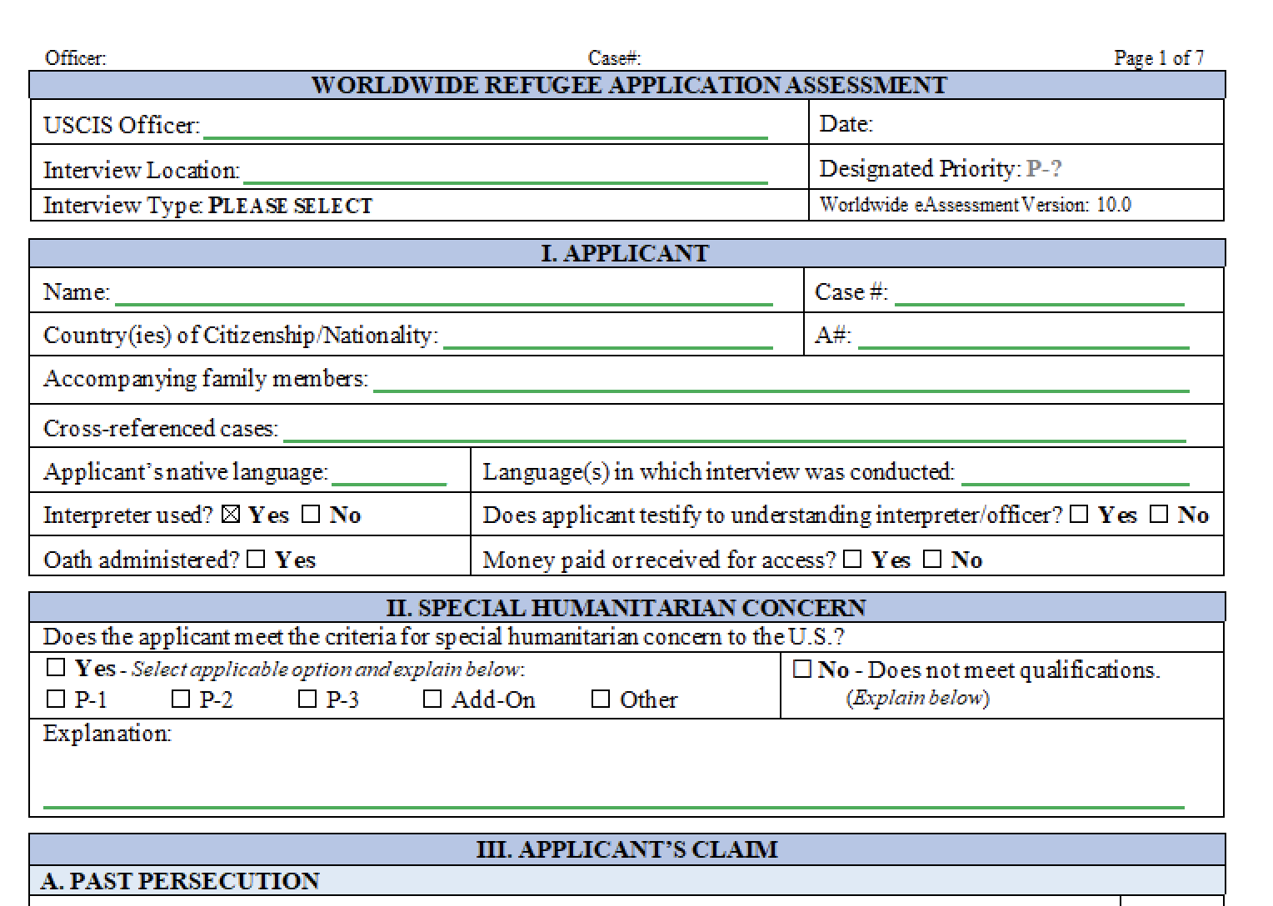
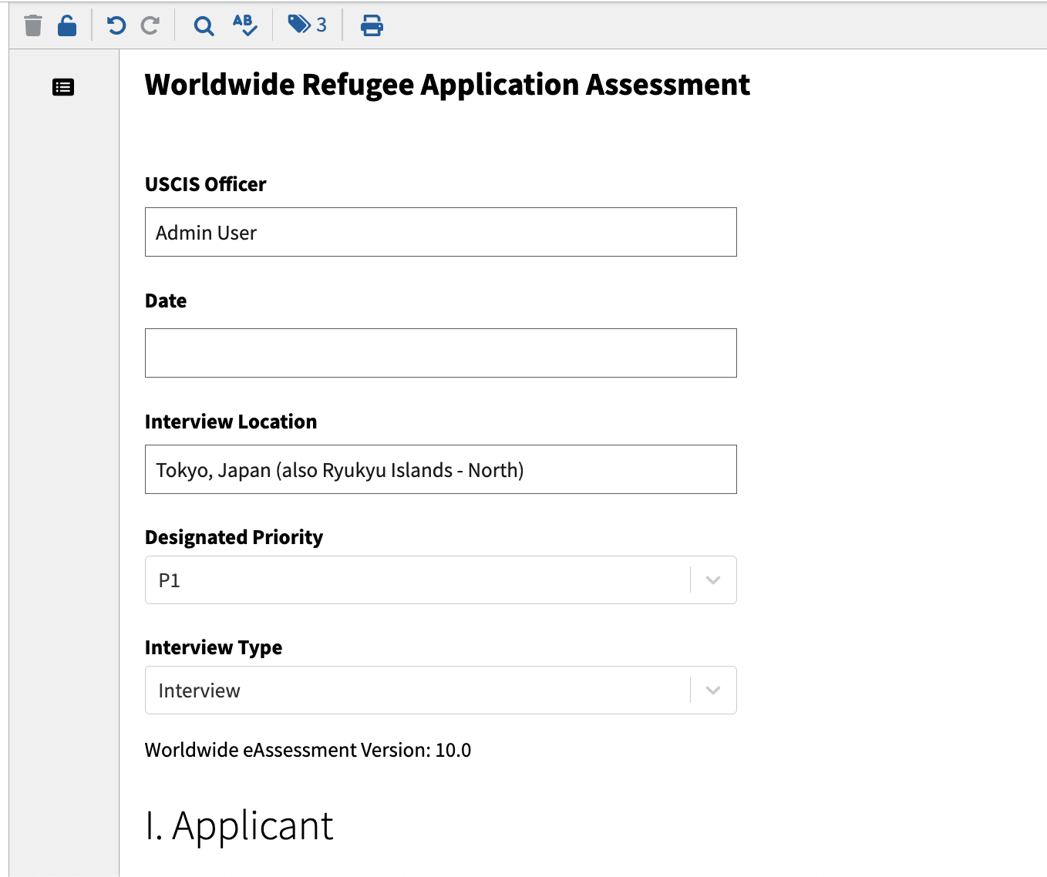
ROs complete assessment in GINA
Word
GINA

Slide 46
Results
Able to process Afghan refugees on average in 25 days from landing in Doha to decision
Including approval in 11 days
Since April 1, 471 interviews and assessment conducted in GINA
“I think Global, and interview app paired with GINA is faster overall. It's certainly faster to review. And clearer.” – Senior Refugee Officer

Slide 47
Questions?

